Slide 1
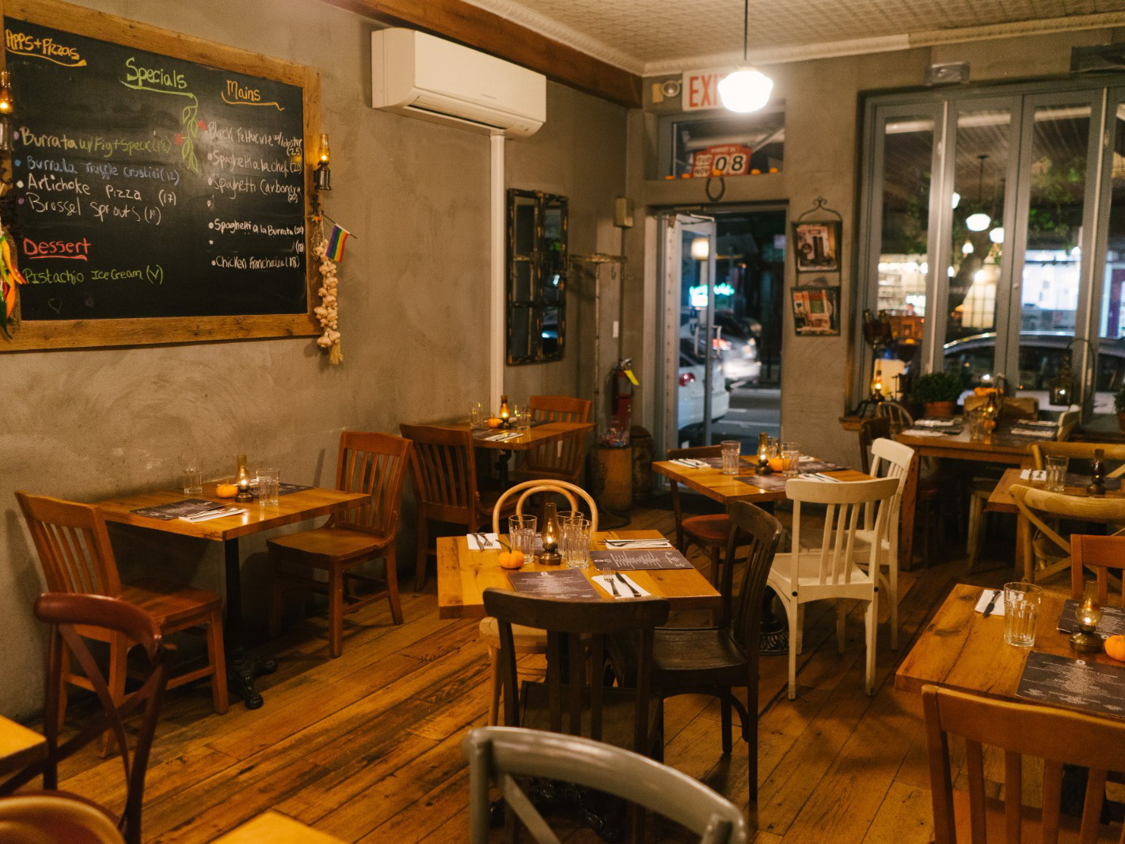

Mario and Luigi’s pizzas
Group 7-1:
Ciuperca Diana
Demirci Alpay
Dulgerov Stefan

Slide 2

TABLE OF CONTENTS
01.
02.
03.
THE PRODUCT
FEATURES
REFLECTION
Team
Problems and solutions
Beginning/Process
Prototype
Local interface
Multiple interfaces
Easier and more effective communication
Database
Smart oven
What went well
What didn’t go well
Task division
Teamwork
What we learnt
What to improve

Slide 3
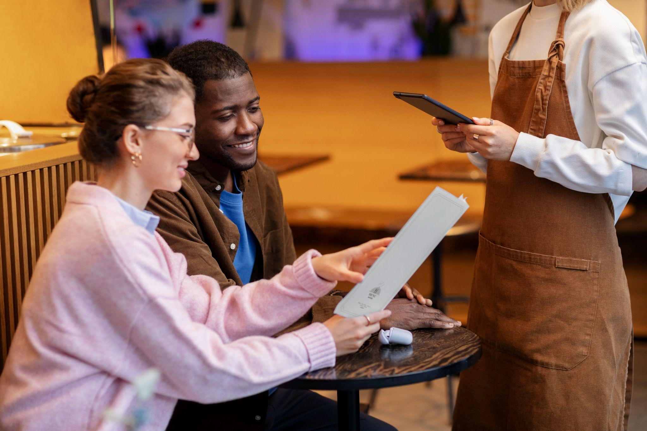
01
ABOUT THE PRODUCT

Slide 4

OUR MEMBERS
01
02
03
04
Ciuperca Diana
Demirci Alpay
Dulgerov Stefan
Zwartenkot Pjotr
Team leader
Lead developer
Developer
Absent

Slide 5
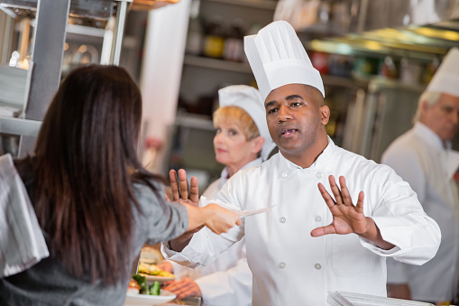
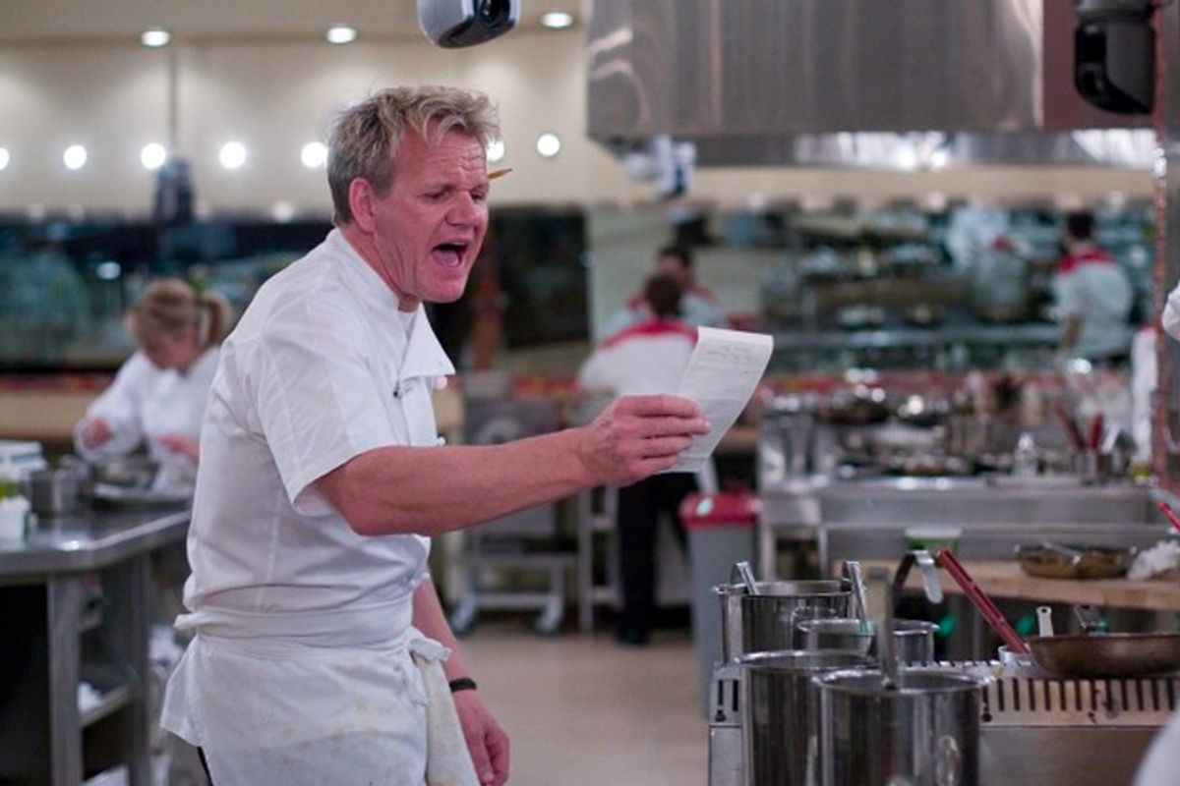
Problems
Solutions

Slide 6
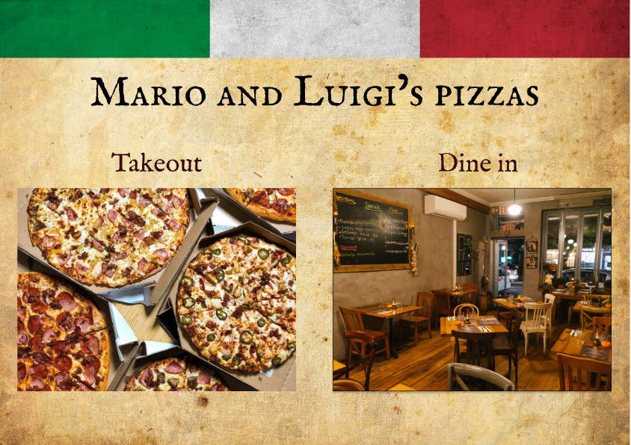

Slide 7
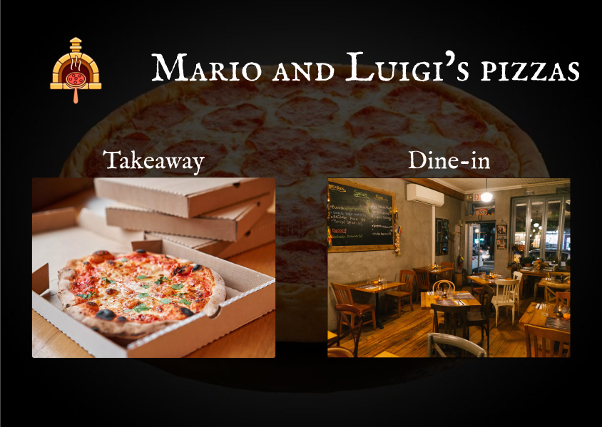

Slide 8
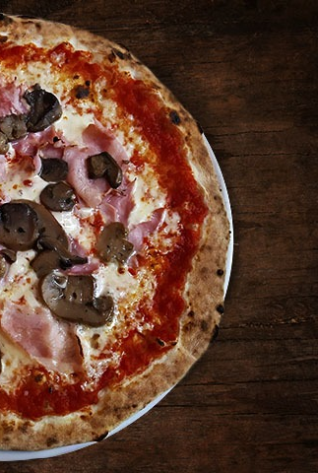
02
FEATURES AND FUNCTIONALITY

Slide 9
Technical features
Used
Database
Smartoven
Python/Flask
Html/CSS
Javascript/Jquery
SQL
Database
Primary keys
Foreign keys
Arduino

Slide 10
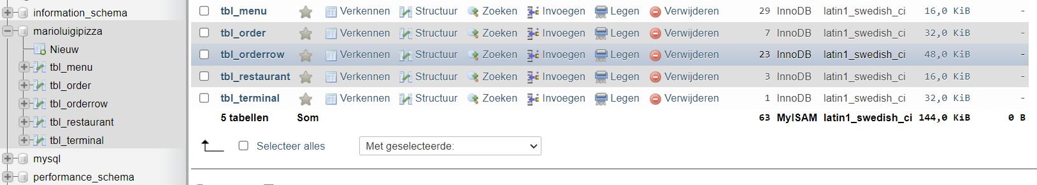
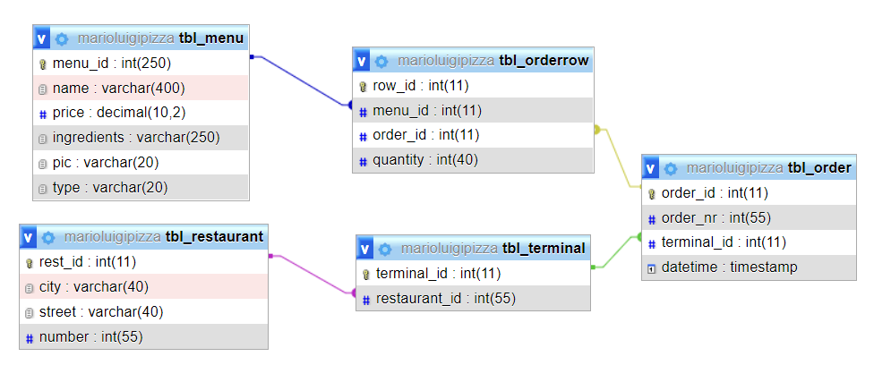
Database

Slide 11
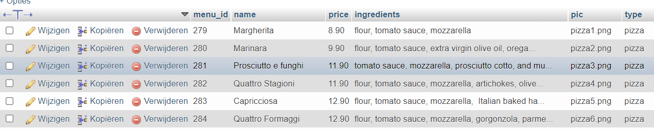
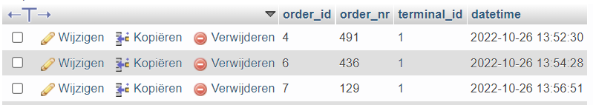
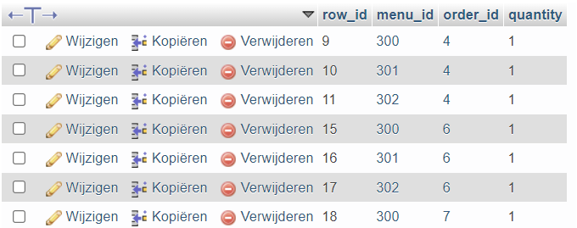
Database
tbl_menu
tbl_order
tbl_orderrow

Slide 12
Pages
Customer:
Home
Menu
Order details
Ordered screen
------------
Staff:
Cashier page
Chef page

Slide 13
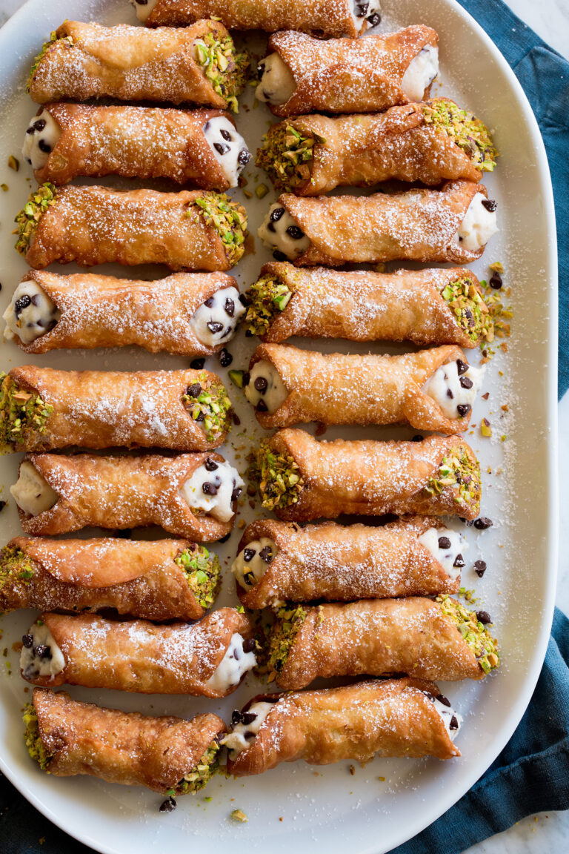
03
REFLECTIONS

Slide 14
TEAM MANAGEMENT
What went well:
What didn’t go well:
Communication
Project ideas
Documentation
Prototype
Teamwork
Implementation
Deadlines
Task division for implementation

Slide 15
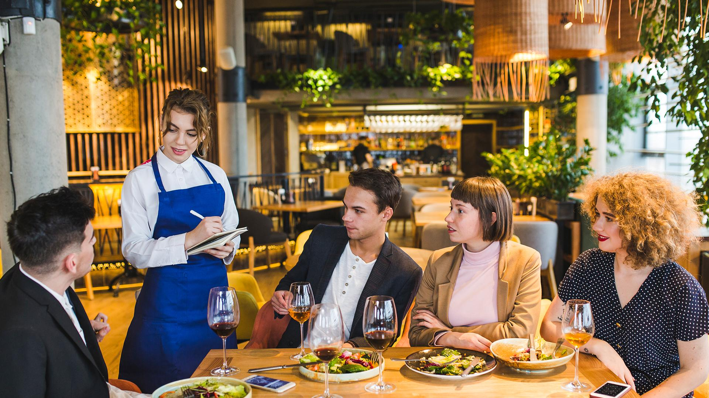
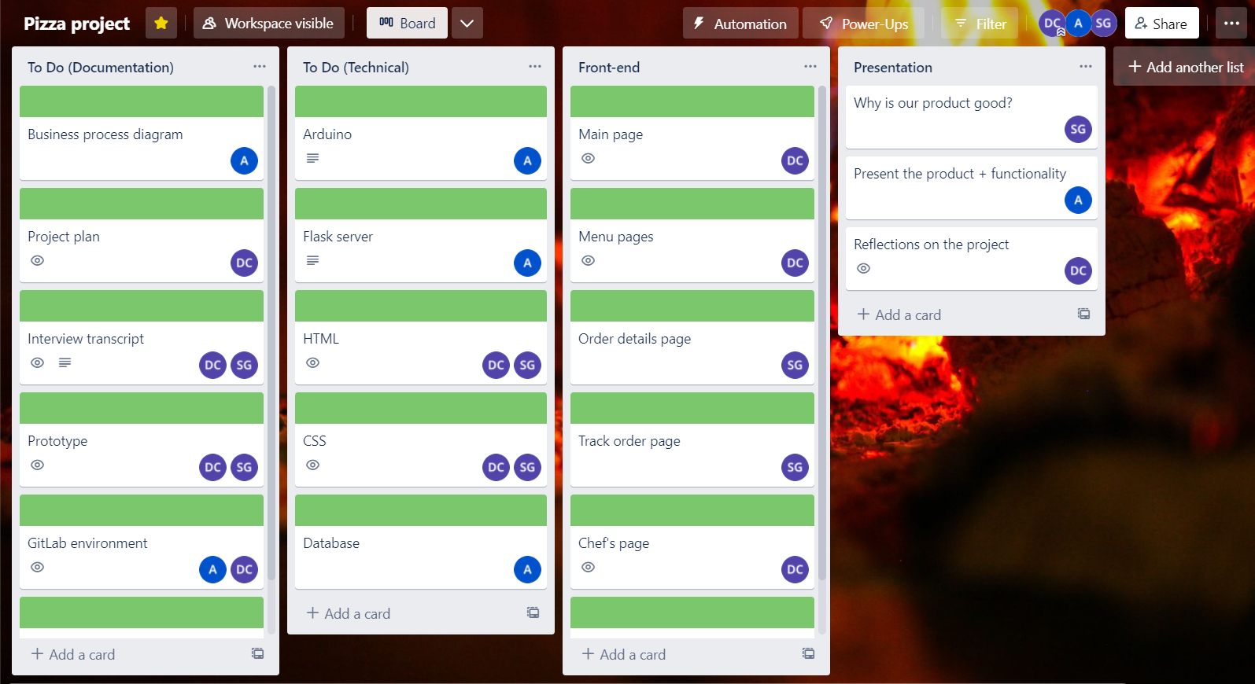
TASK DIVISION - TRELLO

Slide 16
OUTCOME
TEAMWORK
LESSONS
IMPROVEMENTS
Small group
Good communication
Strong connection
Time management
Cooperation
GitLab
Workload
Deadlines

Slide 17
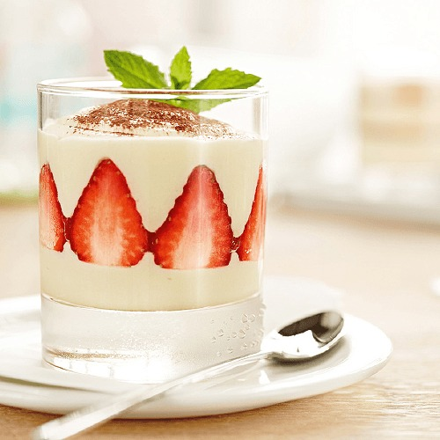
THANK YOU!

